Slide 1
Neural Networks – Hyperparameter optimisation
Finding the optimal optimiser

Slide 2
Network Hyperparameters
Number of layers (usually 2 for an RNN)
Number of neurons per layer (symmetric or asymmetric)
Activation functions
Node/arc weightings
Learning rate
Number of Epochs
Batch size
Context specific variables
Optimising these parameters ensures the neural network is optimal.
Activation functions: sigmoid or tanh, both suffer from vanishing gradient problem. ReLU, linear above 0.

Slide 3
Hyperparameter optimisers
Baseline methods – Grid/Random search
Bayesian Optimisation - Gaussian Processes with expected improvement. - Tree structured (Adaptive) Parzen Estimator.
Surrogate optimisers – GPs and random forests
Population/evolutionary optimisers

Slide 4
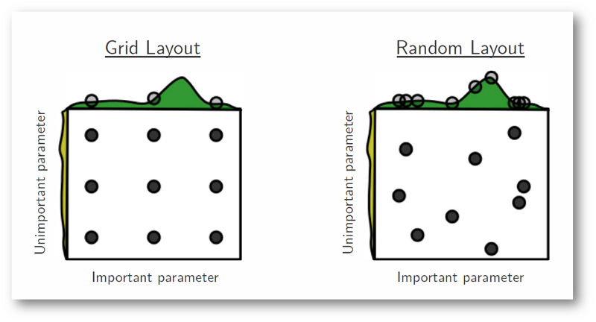
Brute force / trial and error
Training directly using the neural network
Grid search
Choose a subset/range of values for each variable then try every possible permutation.
Relatively simple and straightforward Wastes time searching points adjacent to poor combinations. Can go along entire axis of an insignificant parameter with little gain.
Random search
Sample random combinations. More efficient, some hyperparameters have little significance. Can be combined with hill climb algorithm. Not as thorough; could miss out some optimal solutions if multiple solutions available. (pareto optimal set).

Slide 5
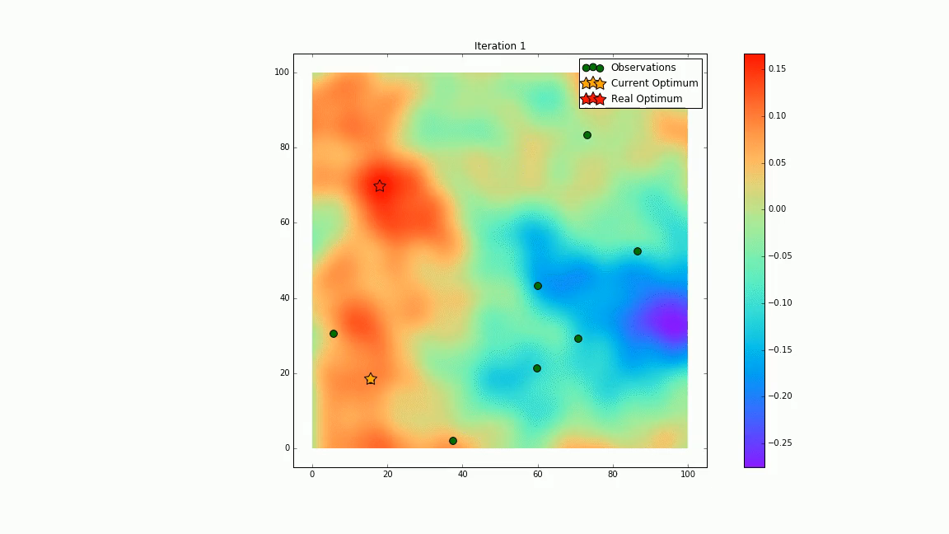
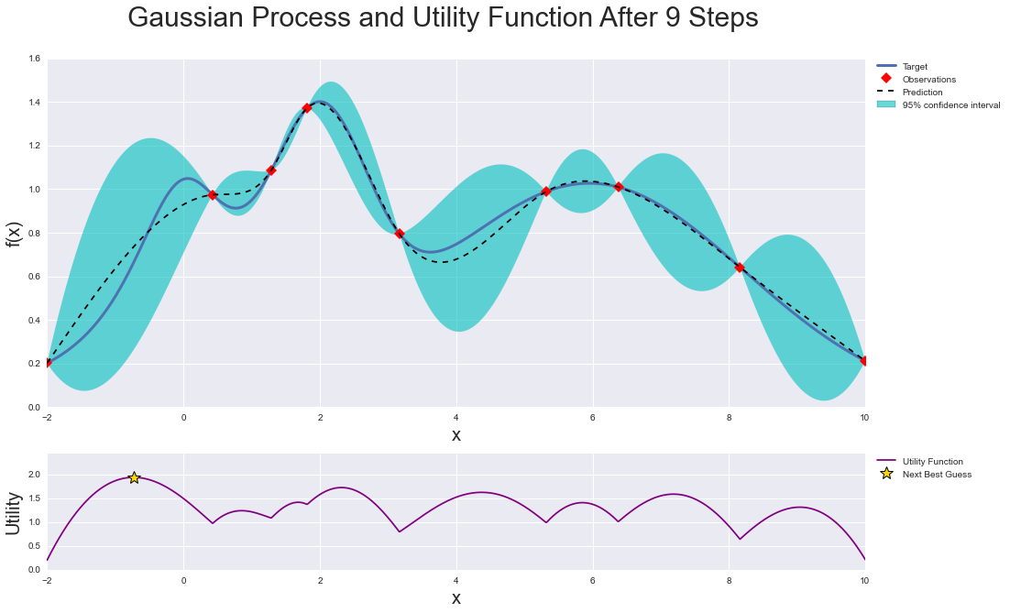

Bayesian Optimisation via Gaussian Processes
Bayesian optimization works by constructing a posterior distribution of functions (gaussian process) that best describes the function you want to optimize. As the number of observations grows, the posterior distribution improves, and the algorithm becomes more certain of which regions in parameter space are worth exploring and which are not.
A Gaussian process which assumes similar inputs give similar outputs (however this would not be ideal for audio/visual based ML).
GP can automatically adjust for scale, i.e. is the output of N = 200 similar to N = 300?
Expected improvement.
Models p(y|x) directly.
Many packages available to implement

Slide 6
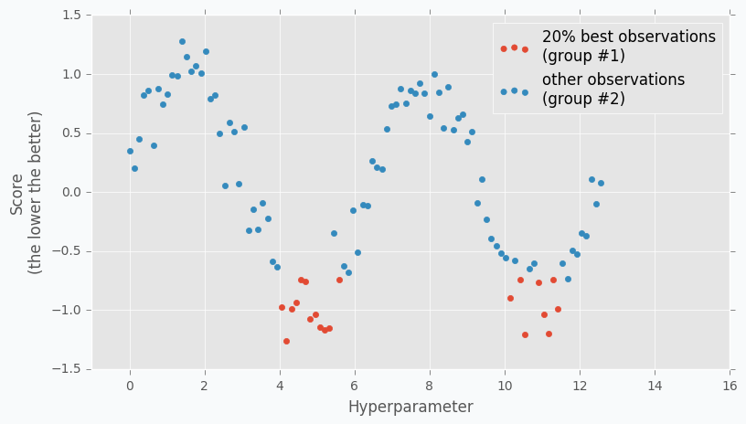
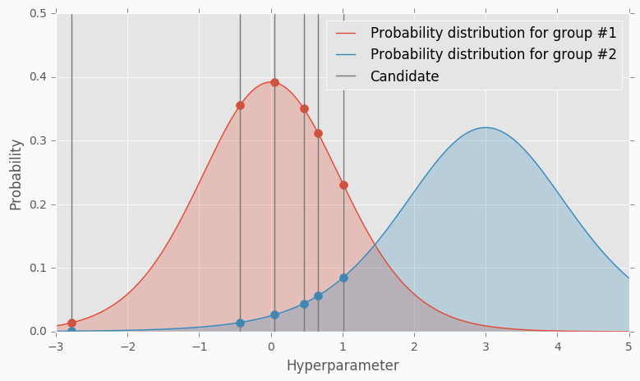
Tree-structured Parzen Estimators (TPE)
Is also a Bayesian optimisation but not a Gaussian process.
Its output and performance is similar to GP but code and architecture is very different.
Also uses Expected improvement but models p(x|y) and p(y), whereas GPs model p(y|x)
Rather than find the next best point out of all available points, it selects a distribution of best points out of all available points.
Typically chooses the best 10 - 25% of all observations each iteration.
Next, the GP uses posterior distributions. TPEs models the likelihood probability from the ‘best observations’ group.
Can be implemented from Hyperopt package http://hyperopt.github.io/hyperopt/

Slide 7
Surrogate optimisation (GP and random forests)
Random forests add some unpredictability/not reproducible

Slide 8
Evolutionary/Population based optimisers
EvoDevo: Deep Neural Network Hyperparameter Optimization with Genetic Algorithms https://www.youtube.com/watch?v=giBAxWeuysM
Evolutionary algorithms, unlike normal ones, are dynamic and can change over time.
EAs have three main characteristics: - Population-based: Generate new sets of solutions from a ‘population’ of current solutions. - Fitness-Oriented: Fitness value associated with each solution calculated from a fitness function. - Variation Driven: If no acceptable solution in current population, mutate/vary population to get new solutions.
Genetic algorithms are a form of evolutionary algorithm. They make only slight variation to solutions, slowly changing until getting the optimal solution.
(I’ve currently only seen it applied in Deep Learning for image processing contexts, and I assume in modelling actual evolution)
Step One: Generate the initial population of individuals randomly. (First generation)
Step Two: Repeat the following steps (forming population generations) until termination:
Evaluate the fitness of each individual in the population (time limit, sufficient fitness achieved, etc.) Select the fittest individuals for reproduction. (Parents) Breed new individuals through crossover and mutation operations to give birth to offspring. Replace the least-fit individuals of the population with new individuals.

Slide 9
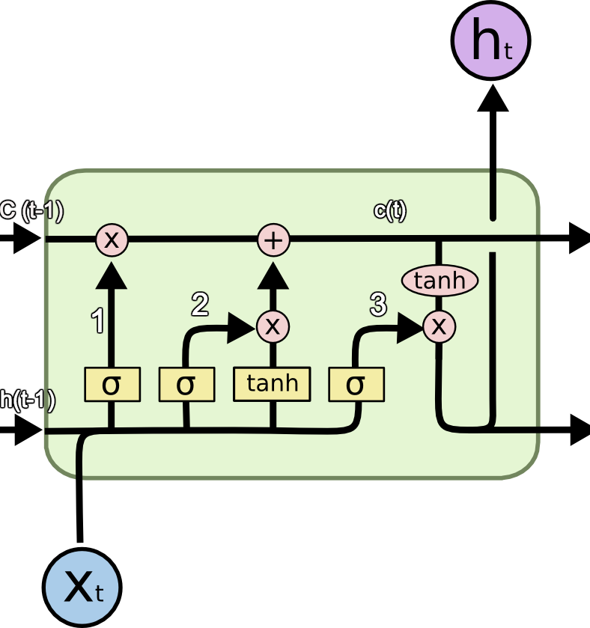
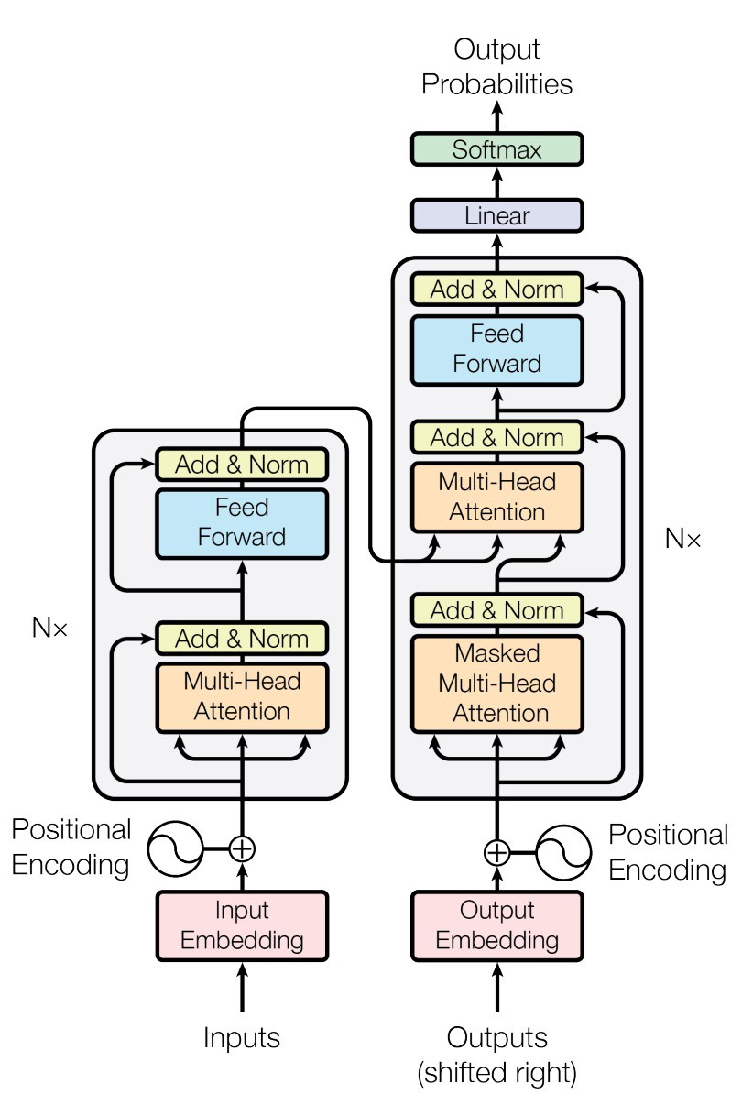
Network architectures: LSTM vs Transformers
Vanilla RNNs suffer from the vanishing gradient problem
Long-Short Term Memory – modified RNN
Transformers – Transformer Neural Network
Recent literature suggest that LSTMs are now outperformed by transformer neural networks
LSTMs are difficult to train, very long gradient paths, need specific datasets for tasks
Transformers allow GPU parallelisation to be fully exploited.
Paper for a CNN which may be better than TNN: “Pervasive Attention: 2D Convolutional Neural Networks for Sequence-to-Sequence Prediction” https://arxiv.org/abs/1808.03867
Seattle Applied Deep Learning lecture – LSTM is dead. Long Live Transformers! https://www.youtube.com/watch?v=S27pHKBEp30

Slide 10

Overview
Baseline methods – Grid/Random search
Bayesian Optimisation - Gaussian Processes with expected improvement. - Tree structured (Adaptive) Parzen Estimator. - Random Forests
Population/evolutionary optimisers
Convex is a 2-way classification dataset and MRBI is a 10-way classification dataset. TPE performed best out of all 4 methods. J.Bergstra et. al. “Algorithms for Hyper-Parameter Optimization”, 2011.
It is clear from literature that Grid < Random < GP < TPE. The more interesting comparisons will be between GP/TPE and the evolutionary genetic algorithms (and others I haven’t researched properly yet).

Slide 11
Plan
Pick a neural network and standardise I/O stream
Implement Grid search, random search and Gaussian Process Bayesian optimisation algorithms, ensuring python modules with standardised I/O.
Create an interface to swap between hyperparameter optimisers modules and different neural networks modules.
Later, look at creating more optimiser modules.
Later, look at more advanced Neural networks
Later, full investigation and ranking of the different optimisers.
Testing data
Evaluation of previous iteration
Training data and hyperparameter list
Chosen neural network (python module)
Optimiser method (python module)
Current hyperparameter
solution
Chosen neural network (python module)
Optimal
solution
Main interface for training procedure

Slide 12
